Slide 1
A Naval Perspective on Cyberwarfare
Implications for the everyday computer specialist

Slide 2
Today’s Talk
Who am I?
What is the Navy?
Why does the Navy care about Ethics?
What is cyber warfare?
What ethical challenges?

Slide 3
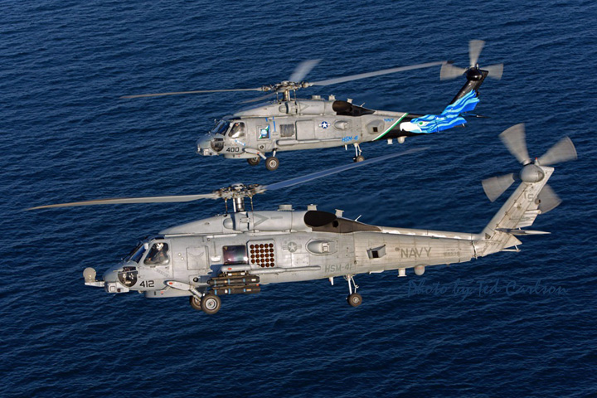
Notes:
Gratuitous picture of the aircraft I last few.

Slide 4
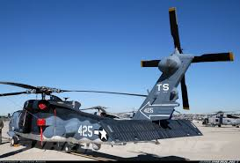
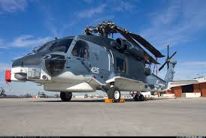
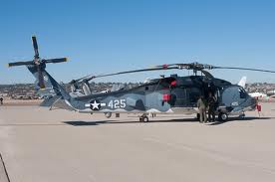
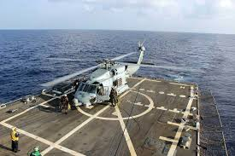
CAPT Shaun McAndrew, USN Navy Pilot
Hometown: Wilkes-Barre, PA
Flying Tours –
Flt School (VT-3/HT-8)
HSL-43 HSL-37
NSA Bahrain (C-12) HSM-41
Staff Tours
NAVCENT/FIFTH Fleet
MNF-I
OPNAV (Pentagon)
NWC
Married with one daughter, 6

Slide 5
What did I do for a living?
Daytime Approach
NVG Approach
Night Approach
Notes:
Enough about me – let me explain more about your Navy, what it is and what it does

Slide 6
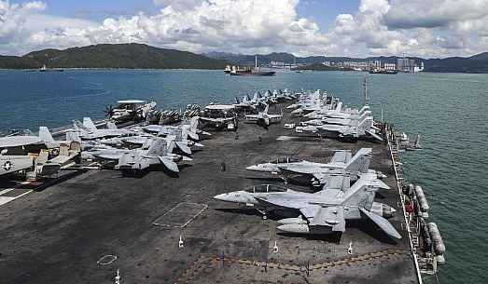
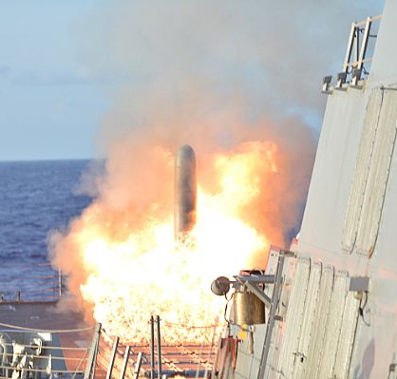
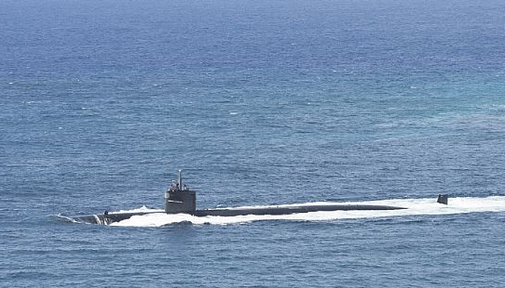
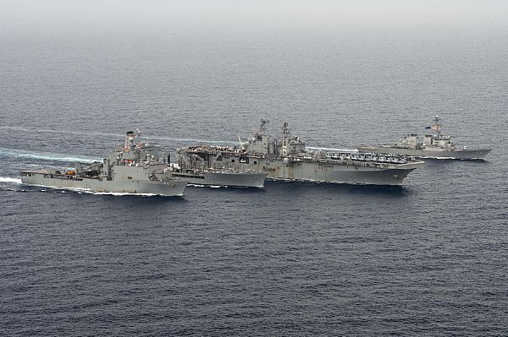
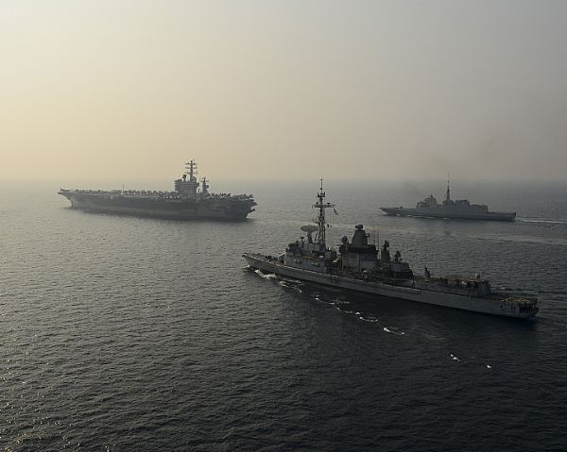
Navy Missions
All Domain Access
Deterrence
Sea Control
Power Projection
Maritime Security
Notes:
Next slide – operate forward
While we have these missions, I thought I would walk you through where we operate and why it is such a global impact.

Slide 7
6 crossroads through which most of our maritime world trade crosses
Notes:
Slides are dated – about 2 years old, but geography does not change rapidly

Slide 8
Bases + Places ➔ Deploy + Sustain
Bases:
Facilities under exclusive U.S. control
Places: Overseas facilities utilized by U.S. naval forces, subject to varying degrees of host nation control

Slide 9
~52 ships
(41 non rotational)
~37 ships
(22 non rotational)
~184 ships
~10 ships
(3 non rotational)
~3 ships
~2 ships
Transit Times (in days)
Total : 279 Ships
Deployed: 97 Ships
40,000 personnel
East Coast - Suez Canal 15
East Coast - Strait of Hormuz 24
East Coast - Strait of Malacca 31
West Coast - Yokosuka 14
West Coast - Strait of Hormuz 32
West Coast - Strait of Malacca 23
Bases
Places
Crossroads
Ships deployed (status as of 16OCT17)
Notes:
Status of the navy
Deployable Battle Force Ships: 279
♦ Deployed Battle Force Across the Fleet Including Forward Deployed Submarines: 97
♦ Deployed Ships Underway: 43 (15%)
♦ Ships Underway for Local Ops / Training: 39 (14%)
♦ Aircraft Carriers Underway:
USS Nimitz (CVN 68) - 5th Fleet
USS Theodore Roosevelt (CVN 71) - Pacific
USS Harry S. Truman (CVN 75) - Atlantic
USS Ronald Reagan (CVN 76) - 7th Fleet
♦ Amphibious Assault Ships Underway:
USS America (LHA 6) - 5th Fleet
USS Wasp (LHD 1) - Atlantic
USS Kearsarge (LHD 3) - Atlantic
♦ Aircraft (operational): 3700+

Slide 10
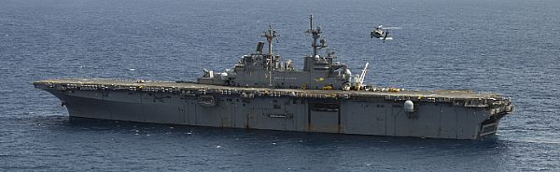
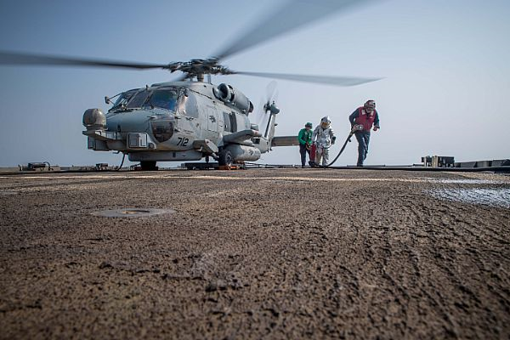
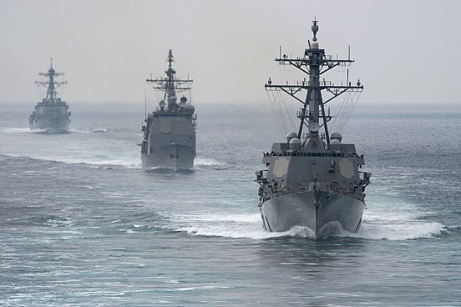
U.S. Navy Ends, Ways, and Means
U.S. Naval Core Capabilities
Forward Presence
Deterrence
Sea Control
Power Projection
Maritime Security
Humanitarian Assistance / Disaster Response
Mission Sets
Counter Air (OCA/DCA)
Strike
Information Warfare (IW)
Interdiction
Close Air Support (CAS)
Anti-Surface Warfare (ASuW)
Anti-Submarine Warfare (ASW)
Amphibious Warfare
Communities and Platforms
Surface
CVN, LHA, LCS, DDG, CG
Submarines
SSN, SSBN. SSGN
Aviation
F-35, F/A-18, E-2C, P-8, MH-60
IW
Cyber, EA-18G, EP-3, I&W
Spec War/Ops
Sample Employment – Think Scalable
Carrier Strike Group (CSG)
Expeditionary Strike Group (ESG)
Surface Action Group (SAG)
Independent Steaming (ISE)
Theater Security Cooperation (TSC)
Humanitarian Relief (HADR)
Afloat C2 / Staff Embark
Notes:
Navy units – ships, submarines and aircraft all tend to be multi mission. They can do more than one thing – sometimes simultaneously, but not always.
The Navy combines its units to support the mission – many times it’s a strike group of some form with either an aircraft carrier or Amphibious assault ship as the primary unit. But the navy will tailor to the requirement.
Explained the importance the Navy plays to National Security, the complexity of the missions and units, so why would ethics play any role in the life of a Sailor?

Slide 11
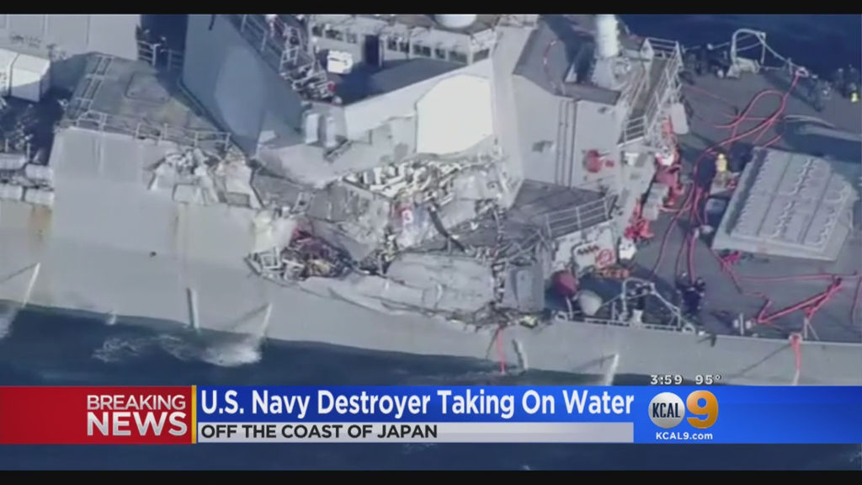
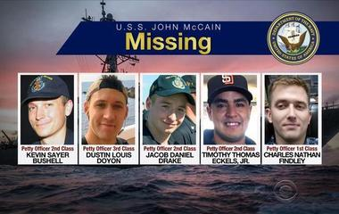
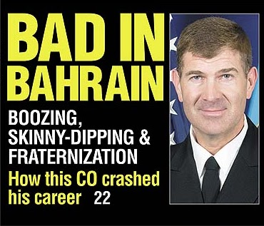
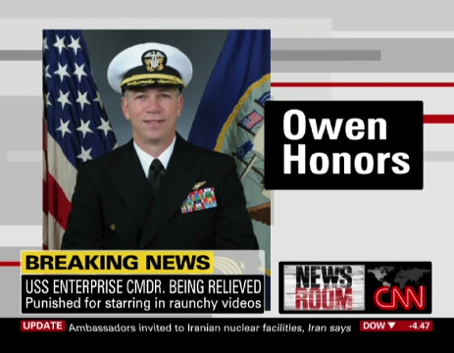
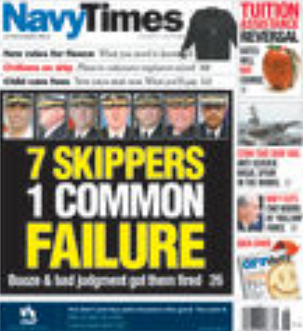
Why does the Navy care about Ethics?
Wrong/bad decisions cost lives, money and credibility
War results in deaths
How does the Navy try to prepare its officers to make good decisions?
Notes:
Most recently, the Navy has been in the news about three ship collisions in a few month time span. I do not have any personal insight into any of those specific events, but it highlight my point that bad decisions reflect poorly on the Navy and it’s ability to do it’s job.
The Navy requires all ROTC Midshipmen who are all future officers to take a Military Ethics course.

Slide 12
Sample of an Ethical Theory
The Principle of Utility
(or Principle of Greatest Happiness)
“The greatest happiness of all of those whose interest is in question, is the right and proper, and universally desirable, end of human action.”
The greatest good for the greatest number
Notes:
The Ethic course teaches about 7-8 ethical theories to assist a future officer work through to better understand their own decision making and how to make decision in line with the Navy’s core values of Honor, Courage and Commitment
The Principle of Utility is a consequential based theory – it looks at the outcome of the actions. There is more than one outcomes based moral theory, but this a quick insight to show you actually may do some ethical reasoning, without even realizing that fact.
Next slide – Mill’s take

Slide 13
Sample of an Ethical Theory cont
John Stuart Mill’s Revisions: “Rule” Utilitarianism
Utilitarianism is NOT equivalent to selfishness. Mill writes:
“. . .between his own happiness and that of another, utilitarianism requires that one be strictly impartial as a disinterested and benevolent spectator.”
“…not the agent’s own happiness but that of all concerned.”
Notions like “rights” and “justice” are merely “rules of thumb” that represent underlying calculations of overall utility (rule utilitarianism)
Notes:
Explain a little about the principle
Student often get frustrated because I will play both sides of the argument to make the point. I rarely state my own beliefs.
Example of one of the theory’s
We’ll go through two examples – first is simple outcomes based thought process
Next slide - doughnuts

Slide 14
Evaluating Actions by Their Consequences
Example: (Not a deep moral issue)
Do I eat the donut this morning?
Considerations:
Long term – at least 500 calories = ¼ pound to my body weight
Short term pleasure – burst of sugar in my mouth
Will make me sleepy after about 45 min.
I love donuts, they make me happy
My heart condition
Does this make me a police officer/SWO?
Other consequences to consider?

Slide 15
Why Does it Matter?
Notes:
Next slide – Cyber warfare defined

Slide 16
Cyberwarfare - What is it?
RAND: Cyber warfare involves the actions by a nation-state or international organization to attack and attempt to damage another nation's computers or information networks through, for example, computer viruses or denial-of-service attacks.
The Dictionary: The use of computers and other devices to attack an enemy's information systems as opposed to an enemy's armies or factories.
CCDCOE:
US/Russia: Cyber attacks that are authorized by state actors against cyber infrastructure in conjunction with government campaign.
South Africa: Actions by a nation/state to penetrate another nation's computers and networks for purposes of causing damage or disruption

Slide 17
“Moral Challenges of the Military” Michael Ignatieff
Moral Numbing
Moral Frustration
Perverse consequences of doing good
Perverse consequences of risk aversion
Targets subjective to legal review
Legal does not necessarily equal moral
Notes:
Discuss in depth if video skipped due to time
Moral Numbing – Ethical implications of stand off weapons and pride in stand-off weapons
Moral Frustration – Enemy not fighting by rules; Temptation
Perverse consequences of doing good – More ethical you are, the more likely that will be exploited by your enemies.
Casualty avoidance is Achillies heal of modern American warfare – Vigilance without overriding our role as diplomats and presence; Ambassadors of our Country’s Values and Ideals
Legal is not ethical – JAG Review/Approval does not equal Ethical GREEN LIGHT
Moral behavior is an individual behavior – Individual Responsibility; Ethical Abdication

Slide 18
Fiction vs. Reality
Trailer for Eyes in the Sky
Fiction – yes, but
Moral dilemmas that may become reality – yes too!
What are they?

Slide 19
Moral Challenges for Cyber Michael Ignatieff, amended by CAPT McAndrew
Moral Numbing – What is beyond the screen?
Moral Frustration – Why can’t I extract revenge?
Perverse consequences of doing good – Why can’t I do that back?
Perverse consequences of risk aversion – Why should I stop doing the good I am doing?
Targets subjective to legal review – I got permission, why can’t I sleep?
Moral courage/responsibility is an individual behavior
Notes:
Discuss in depth if video skipped due to time
Moral Numbing – Ethical implications of stand off weapons and pride in stand-off weapons
Moral Frustration – Enemy not fighting by rules; Temptation
Perverse consequences of doing good – More ethical you are, the more likely that will be exploited by your enemies.
Casualty avoidance is Achillies heal of modern American warfare – Vigilance without overriding our role as diplomats and presence; Ambassadors of our Country’s Values and Ideals
Legal is not ethical – JAG Review/Approval does not equal Ethical GREEN LIGHT
Moral behavior is an individual behavior – Individual Responsibility; Ethical Abdication

Slide 20
Summary
Better understanding of your Navy
Cyber warfare will continue to be a challenge – for all
Ethics and cyber – your decisions DO matter

Slide 21
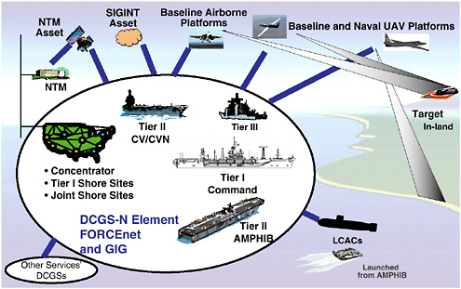
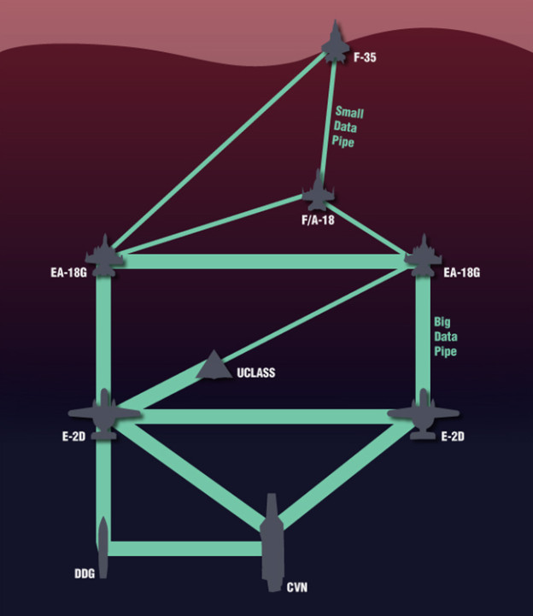
Networked Naval Assets

