Slide 1
CS515: Bioinformatic Algorithms
A Little Bit of Biology: Part II
Dr. Robert Heckendorn

Slide 2
Biology up to the 1960s
What is life?
Let’s catalog it!
Hey wait!.... There’s a pattern… a tree of life. It is even supported by the fossil record!
Evolution can explain this.
But then there has to be particulate heredity. How does that work?

Slide 3
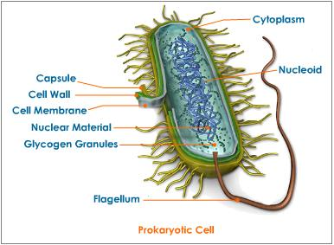
Two Kinds of Cells: Prokaryote

Slide 4
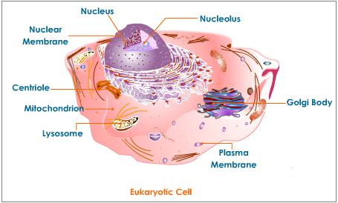
Two Kinds of Cells: Eukaryote

Slide 5
Protein: A building block of life
Structural components
Enzymes act as catalysts including processing DNA
Agents of process such as signaling, transduction, transportation, motor function
Notes:
Struct: elastin, collagen, cytoskeletal structure enzymes: DNA replication and repair, augmenting chemical reactions, (transistor of chemistry)

Slide 6
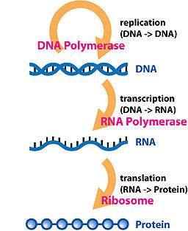
DNA codes protein
Central Dogma of Molecular Biology

Slide 7
Notes: DNA to Protein and other transformations
DNA transcription creates messenger RNA
mRNA translation creates protein
Reverse transcriptase allows the copying of RNA to DNA (retroviruses)
RNA copying occurs in RNA viruses
Information flows DNA to protein

Slide 8
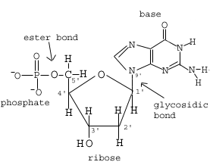
The Structure of DNA: The Nucleotide
Note the numbering of
the carbon atoms
Notes:
Sparknotes.com

Slide 9
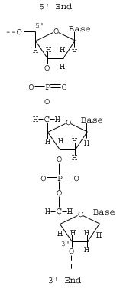
The Structure of DNA: The Sugar Backbone
Read this direction
Notes:
Sparknotes.com

Slide 10
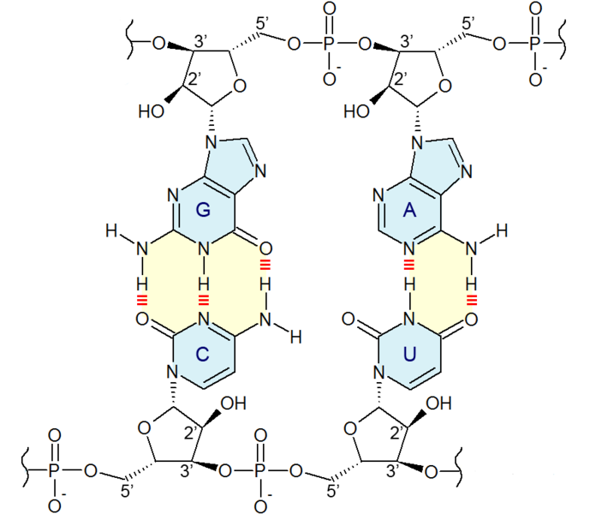
DNA Structure

Slide 11
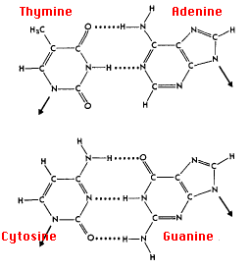
The Structure of DNA: The Bases in Pairs
Pyrimidines - Purines
Notes:
Sparknotes.com

Slide 12
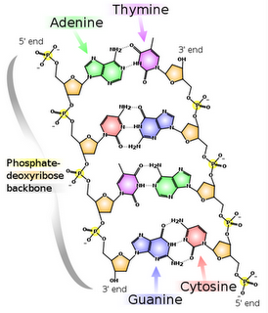
The Structure of DNA: The Double Strand
Notes:
Sparknotes.com

Slide 13
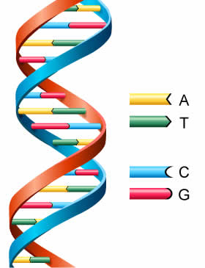
The Structure of DNA: The Double Strand
Notes:
Sparknotes.com

Slide 14
DNA: Complementary Strings
5’ ATACGACTATTCCG 3’
3’ TATGCTGATAAGGC 5’
The second string is written:
CGGAATAGTCGTAT
upstream
downstream

Slide 15
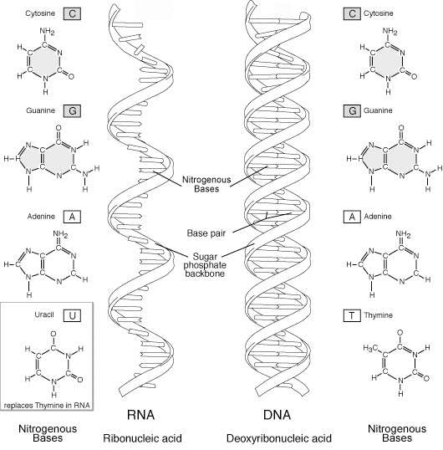
The Structure of RNA
Uracil for Thymine and hydroxyl group at 2’
Notes:
Wikipedia on RNA

Slide 16
Transcription
Coding and noncoding strands
Rips the 5’ to 3’ DNA strand initiated by promoter
Multiple copies can be made at once
RNA polymerase
RNA
Notes:
wikipedia

Slide 17
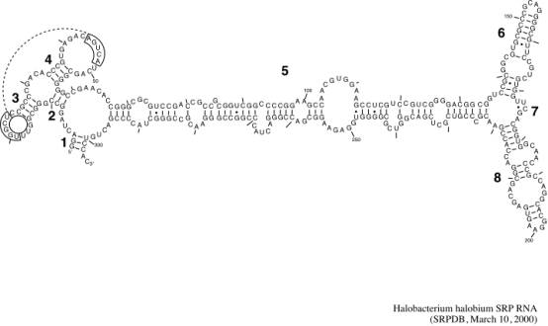
RNA folds on itself

Slide 18
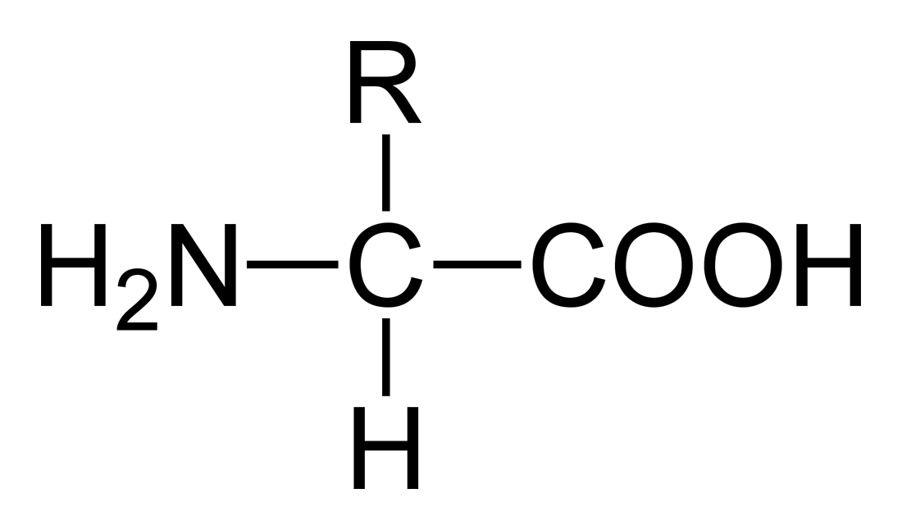
The Structure of Protein: The Amino Acid
α carbon

Slide 19
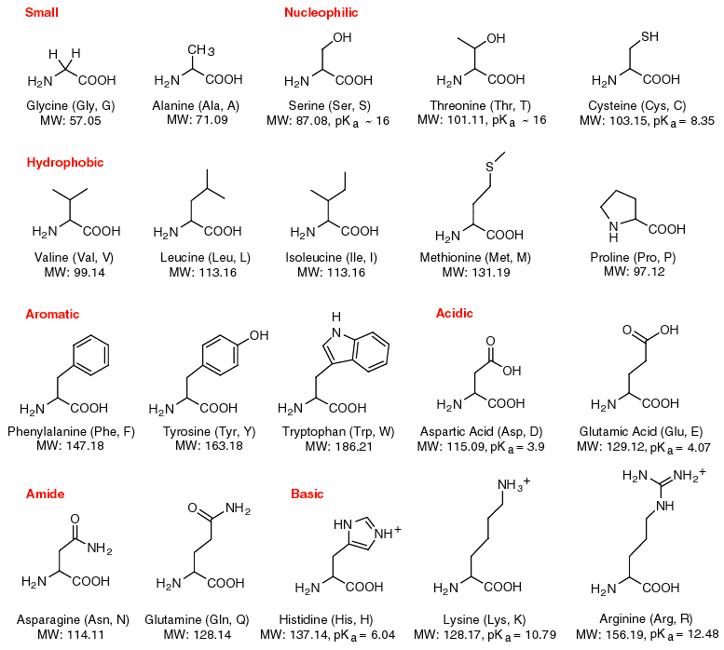
The 20 Amino Acids

Slide 20
The 20 Amino Acids (cont’d)

Slide 21
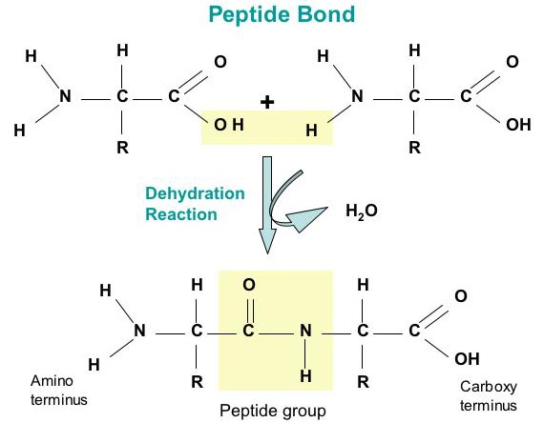
Peptide Bond
A residue is what is left of amino acid after water is discarded

Slide 22
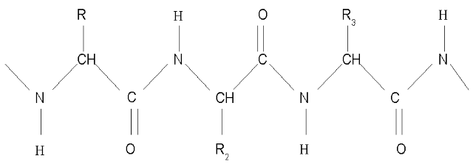
Polypeptide Chain is a Protein
Alpha carbons can rotate in any angle!

Slide 23
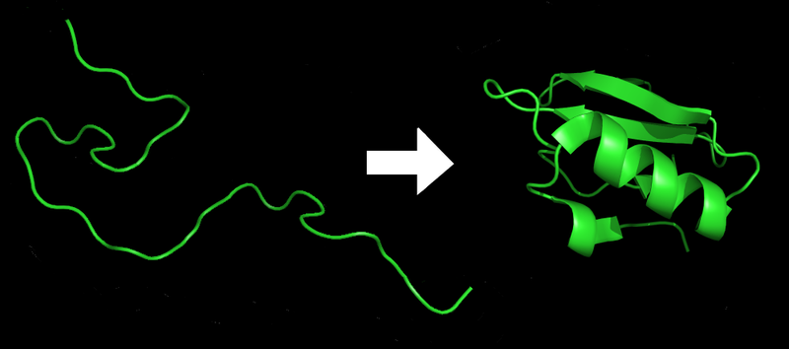
Protein Folding

Slide 24
Protein Sequences
labeled: ACDEFGHIKLMNPQRSTVWY Missing: BJOUXZ
…EADWMTVLYIWPRKKEVPQR…
or
…CHARACTERISTICALLY…

Slide 25
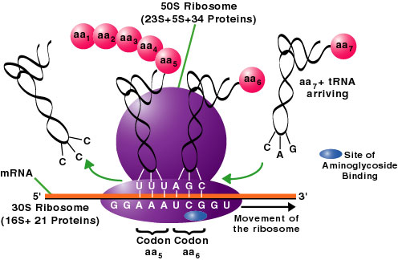
Translation
tRNA = transfer RNA

Slide 26
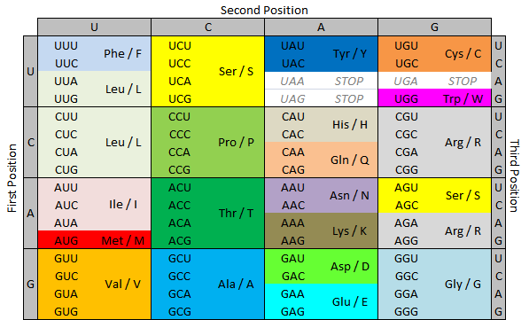
Codon to Residue Table

Slide 27
Six ways to read an RNA/DNA string
Right to left or left to right
Three positions for reading frame
UCAGACCUUCUA

Slide 28
Some details of DNA to protein pathway
Prokaryotes
DNA is “loose” in the cell
DNA is in a single gene
All DNA is used for encoding (few exceptions)
Eukaryotes
DNA is in nucleus
DNA is in multiple chromosomes
RNA is edited by splicing to eliminate noncoding introns and preserve coding exons

Slide 29
Splicing of mRNA to mature mRNA

Slide 30
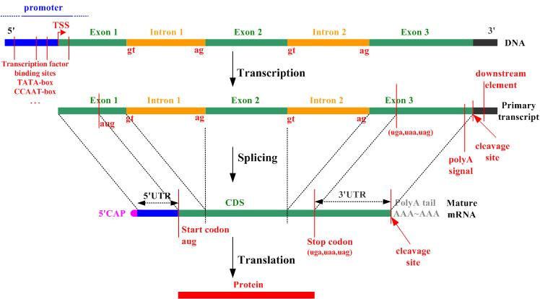
Splicing of mRNA to mature mRNA

Slide 31
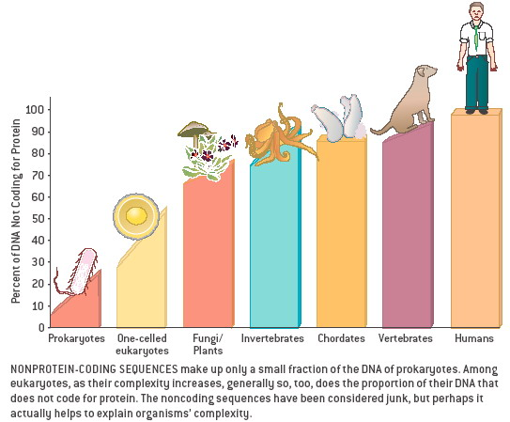
Noncoding DNA

Slide 32
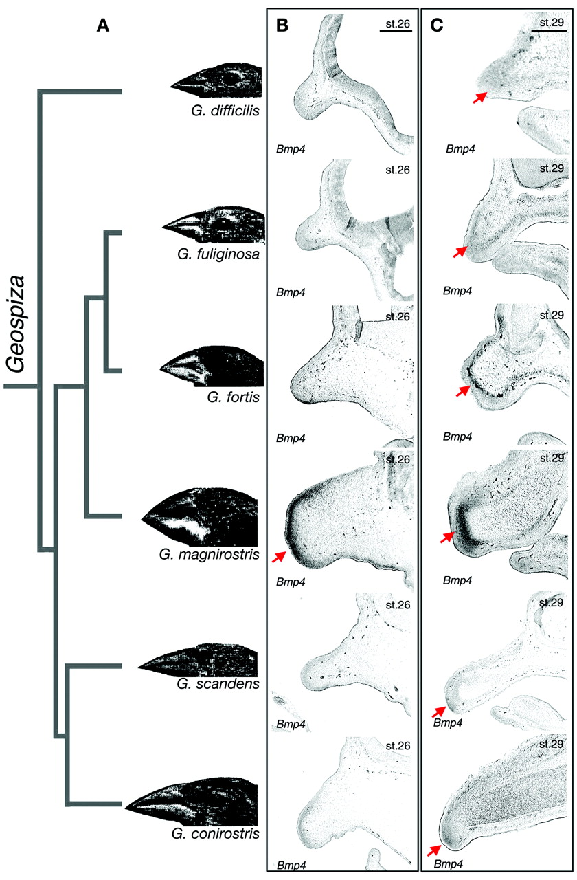
Taxonomy From Characters

Slide 33
Taxonomy From Characters
CGGGTTAGAAGTAT
CGGAATAGTCGTAT
CGGATTAGTCGTAT
CGGGTTAGTCGTAT
CGGGTTAGACGTAT
CGGGTTAGACGTAT

