Slide 1
CS515: Bioinformatic Algorithms
A Little Bit of Biology: Part I
Dr. Robert Heckendorn

Slide 2
Fundamental Questions
What is Life?
What makes something alive?
Where does it come from?
Was it always here?
What is the difference between one animal and another?

Slide 3
More Fundamental Questions
What is the difference between an alive thing and a dead thing? They look the same.

Slide 4
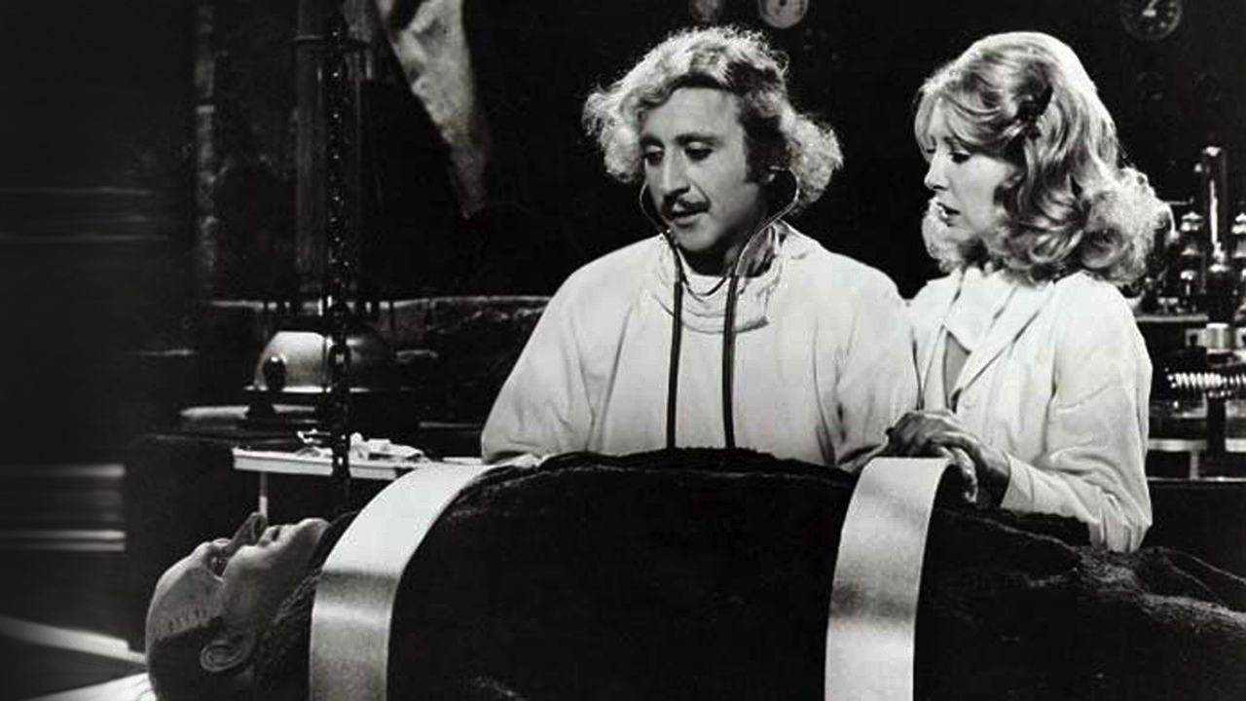
Fundamental Questions
Can we create life?

Slide 5
Humankind’s Response
Science:
gather data
make predictive models
test them
use them

Slide 6
Humankind’s Response in the 21st Century
Science with the aid of computers:
gather petabytes of data
make predictive computer models
run them and test them
use them

Slide 7
So how did we get here?

Slide 8
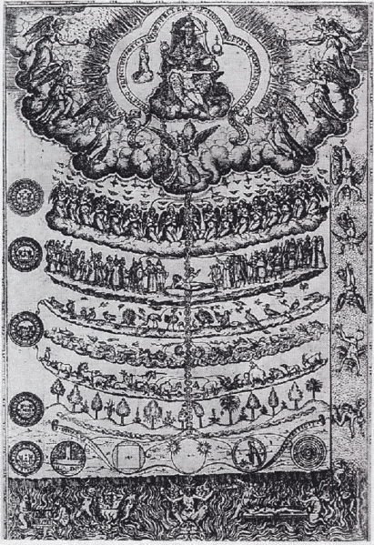
Middle Ages: Scala Naturae Order of life is fixed

Slide 9
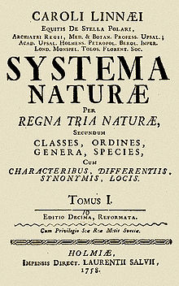
Linnaeus: Classification Early 1700s
Gather data about
animal types
Classify animals

Slide 10
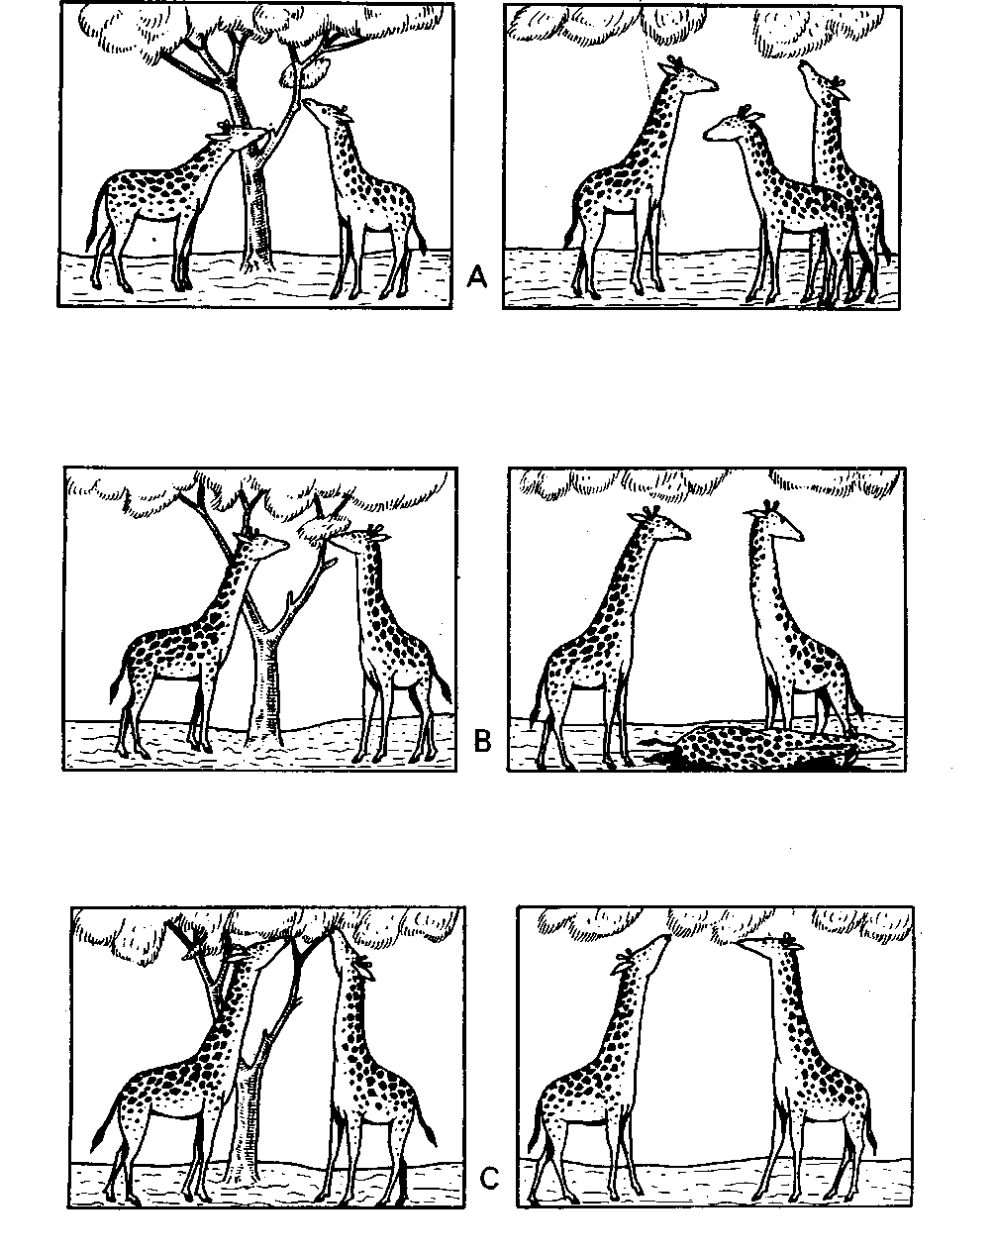
Lamarck: Evolution through use and disuse Late 1700s
Complexification
Adaptation to environment

Slide 11
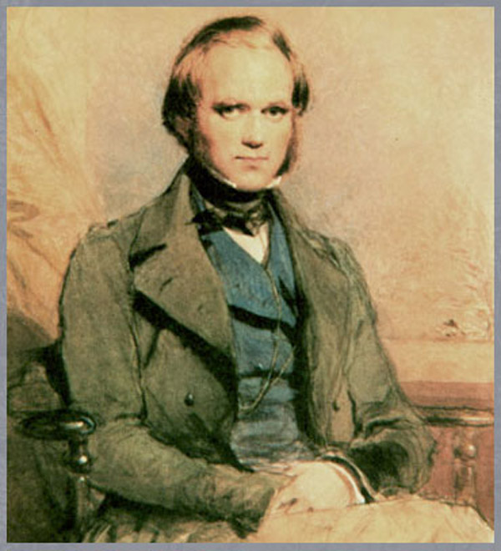
Charles Darwin (1809-1882)
1831-1836 Voyage of the Beagle
1859 On the Origin of Species

Slide 12
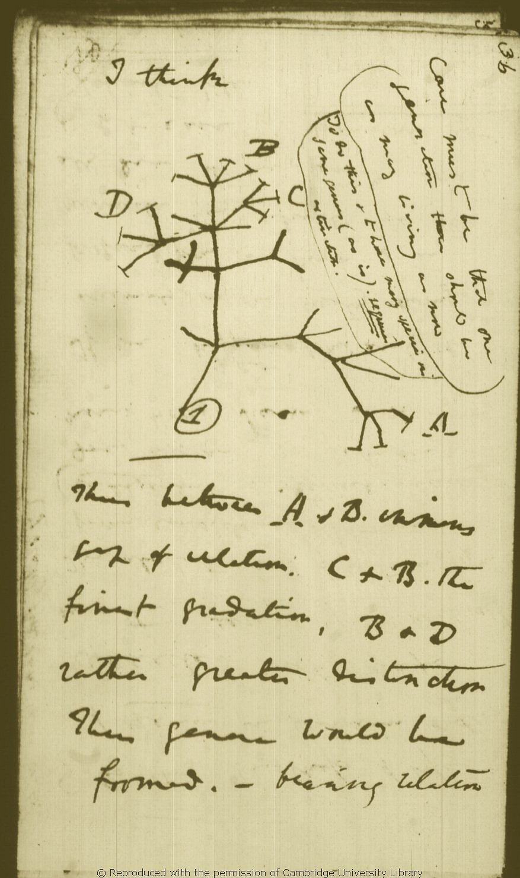
Darwin’s Tree of Life

Slide 13
Darwinian Evolution
Population
Reproduction
Heredity
Variation
Selection

Slide 14
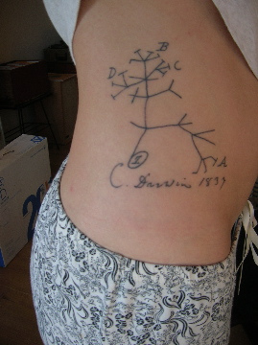
Darwin’s Tree of Life

Slide 15
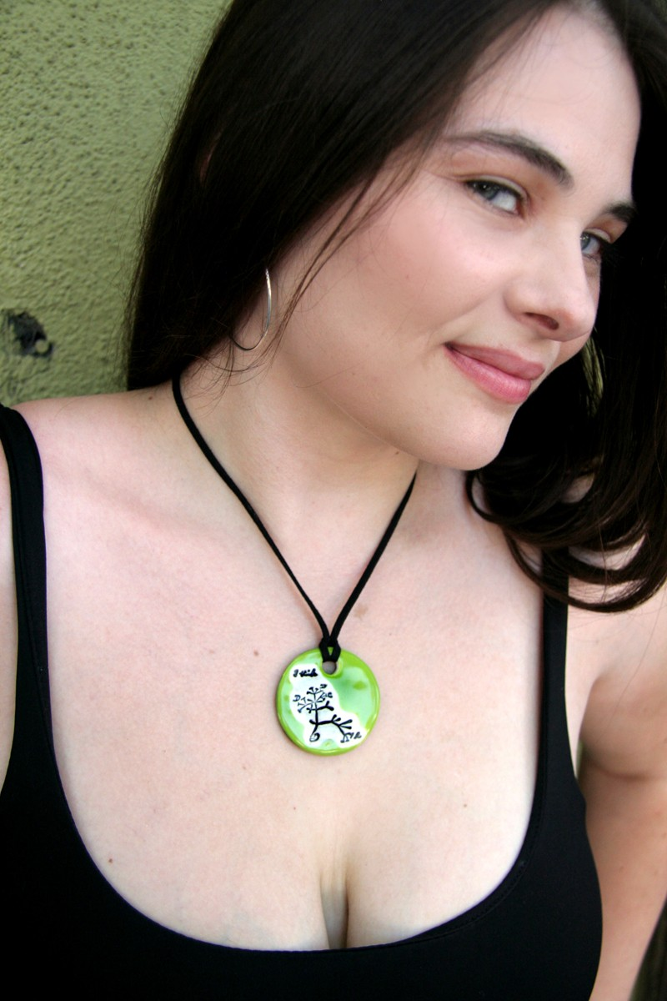
Darwin’s Tree of Life

Slide 16
Taxonomy Now Makes Sense!
"Nothing in biology makes sense, except in light of evolution.”
-- Theodosius Dobzhansky

Slide 17
New Fundamental Questions
How did life evolve?
Which feature appeared before which?
How does evolution work? What are the parts to the process?
What species are most closely related?

Slide 18
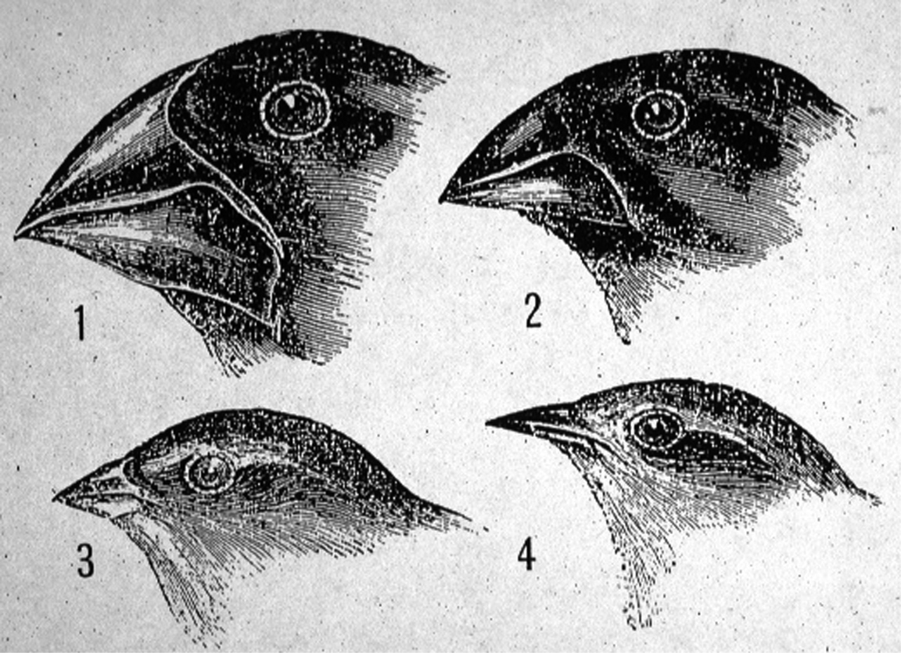
Taxonomy and measurement
Measure characters
Gives measure of closeness of species in “family tree”

Slide 19
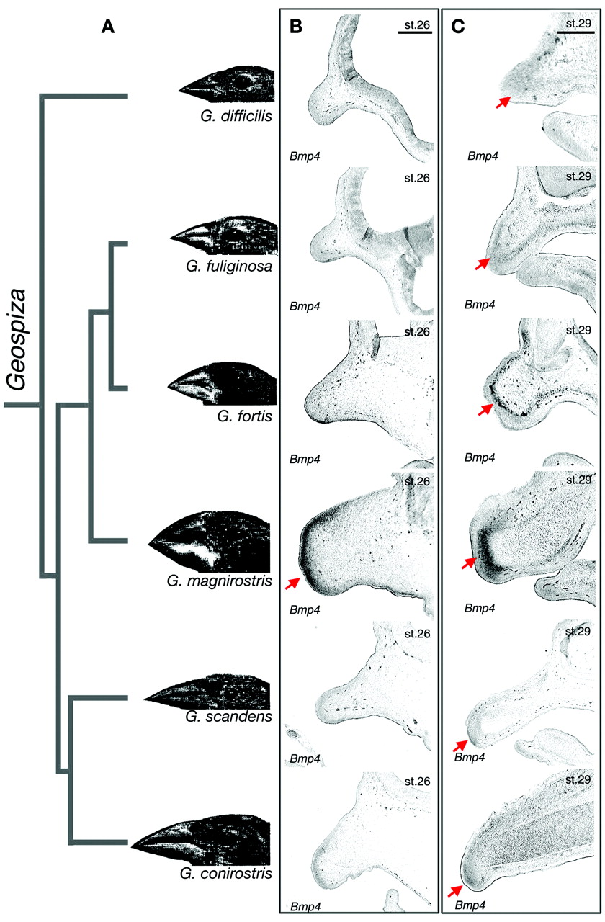
Taxonomy From Characters

Slide 20
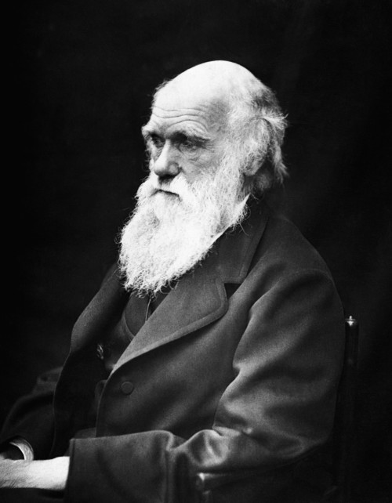
Darwin Troubled
Why doesn’t a species converge to a average of all parents?
How does heredity work?

Slide 21
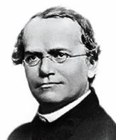
Gregor Mendel (1822-1884)
1866 experiments suggest that genes are particles!
OMG! Genes are heredity!
Genes could be characters.

Slide 22
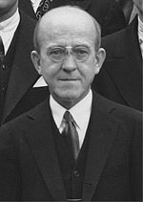
Genes are DNA
1944 Oswald Avery et al. discover that genes and chromosomes are made of DNA

Slide 23
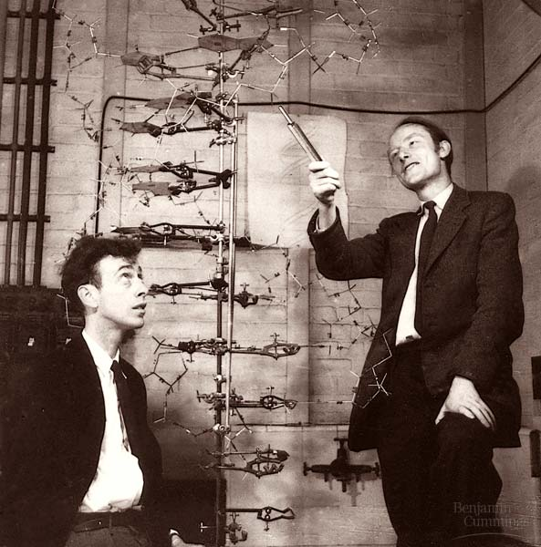
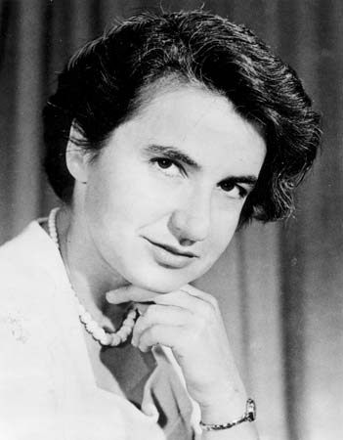
The Structure of DNA (1953)
Crick and Watson
Rosalind Franklin

Slide 24
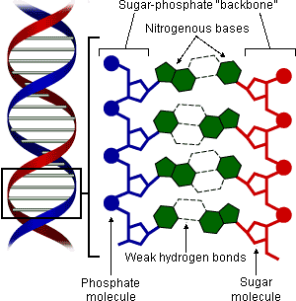
DNA is a molecule and a sequence
Deoxyribonucleic acid (DNA)
4 base pairs (bp)from a DNA strand

Slide 25
Yet More Fundamental Questions
Is this really the code of life? How does that work? How big is it?
Is everything of what something is found here?
If every cell of a creature has the same DNA why are there different cells?
What is the code for each species and how much variation is there?

Slide 26
The Whole Genome for Creatures
1978 - viral DNA phiX174 - size: 5kbp
1995 - first bacteria - size: 1.8Mbp
1997 – E. coli - size: 4.6Mbp
2000 – D. melanogaster - size: 180Mbp
2000 - Arabidopsis - size:125Mbp
2001 - Homo sapien – size: 3Gbp

Slide 27
The Whole Genome for Many More Creatures…
2002 - Mouse
2004 - Chicken
2004 - Silk worm
2005 - Dog
2006 - Homo sapien (complete)
2006 - Honey bee
2009 - Cow
2010 - Neanderthal (draft)
2012 - Yak

Slide 28
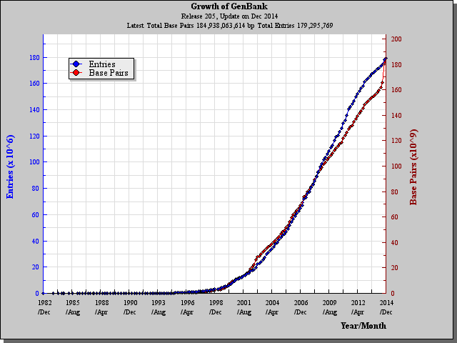
Growth of GenBank (DNA) Database

Slide 29
Growth of UniProt (Protein) Database

Slide 30
Common Bioinformatic Tasks
Search for similar sequences
Align sequences that are not quit equal
Assemble sequences from sequence fragments
Infer evolutionary history from comparable subsequences of DNA

Slide 31
Common Bioinformatic Tasks (Continued)
Infer shape of physical DNA, RNA, or Protein
Find regions of proteins with certain general properties
Classify genes by sequence similarity
Determine which genes are “on”
Infer regulatory networks

Slide 32
Common Bioinformatic Tasks (Continued)
Infer number of species present by DNA sample from biome
Fingerprint and analyze species distribution of biome

